Slide 1
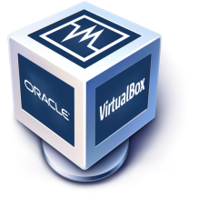


AWS
Important Topics!
Computer
Data
Operating System
Network
Virtualization
Virtual Machine
Cloud

Slide 2
AWS
What is Computer?
Computer is an electronic machine.
CPU > RAM > Hard-disk > SMPS > Mother Board > Cabinet > Monitor > Keyboard and Mouse
Invented by Charles Babbage – 1837.
We can use computer to store, access and transfer our data.
Notes:
Ref : doc.html -> 2 to 17

Slide 3
AWS
How Computer came?
Mankind was in need to store the “Information’s”.
What are those information's? Experiences or something
Why they need to store information's? To pass it to other people or their next
generations
How people started to store information's? Languages>Writings>Inscription& Maple
leaves>Paper!
Notes:
Ref : doc.html -> 2 to 17

Slide 4
AWS
Paper VS Computer
We are migrating from Paper to Computer age!
Floppy
CD/DVD drive
Pen drive
External Hard Disk
Memory cards
Paper | Computer
Need huge storage space | Very less Storage space
Took more time for copy | Very quick in copy / move
Heavy risk | Low risk
Need number of resources | Need low resources
Notes:
Ref : doc.html -> 2 to 17

Slide 5
AWS
How we are handling information's ?
Simple Duplex====> Radio & TV
>Receive from one side
Half Duplex====> walkie -Talkie
>sending and receiving from 2 sides Data!
Full Duplex ====> Landline/Mobile/Internet Communication
>sending and receiving simultaneously from 2 sides

Slide 6
AWS
What is Data?
Collection of information is called Data.
Programs are designed to process and manipulate data, while data serves as the input to these programs and the output produced by them.
A program, in the context of computing, refers to a set of instructions written in programming language that defines a sequence of operations to be performed by a computer.
Collection of program is called Application Software.
>System Software
>Application Software
Operating System = System Software

Slide 7
AWS
Operating System !
Interface between user and machine(Computer)
Resource manager of a computer.
It will manage the processes, memory and files.
Different types of OS !
Linux
Microsoft windows
Apple MAC OS

Slide 8
AWS
How server is controlling client Computer?
Server computers and client computers are connected in “Network”.
We need to configure server computer configuration in client computer.
Client requests will handle by the server and it will respond to the client.

Slide 9
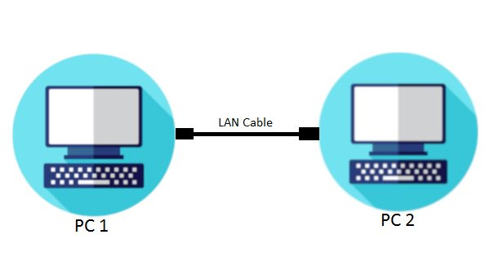
AWS
Data Transfer between Two Computers!
Application>Data>NIC>Packet>Transfer in cable>Packet>NIC>Data>Application
Application Layer | Sending a doc file
Transport Layer | It is segmenting a data into smaller units called segments.
Network Layer | The segments are further encapsulated into packets, it contains source and destination IP address.
Data Link Layer | This layer adds physical address known as MAC and packets are boxed in frame.
Physical Layer | The frames are converted into electrical or optical signals that can be transmitted over the RJ 45 cable.

Slide 10
AWS
Data Transfer between Two Computers!
Reception & Decoding | NIC – It receives the signals and convert them back into Frames.
Data Link | It checks the Mac address, if the frame is for the receiving NIC then frame is accepted else ignored.
Network | It extracts the packet from the accepted frame and checks the destination ip address.
Transport | If above correct, then it will extracts the segments and reassembles them into the original data.
Application | Finally, the data is delivered to application, it will process and use the received information.

Slide 11
AWS
How data Transfer between two computers?
Network Devices
IP Addressing
Subnetting
Public Network
Private Network
Virtual Network
VPN – Virtual Private Network
Notes:
Ref : doc.html -> 1662 to

Slide 12
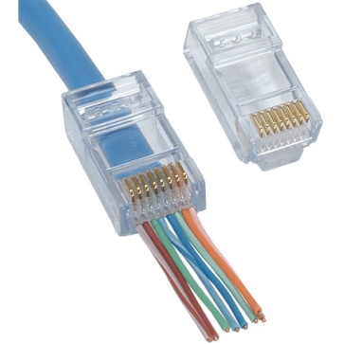
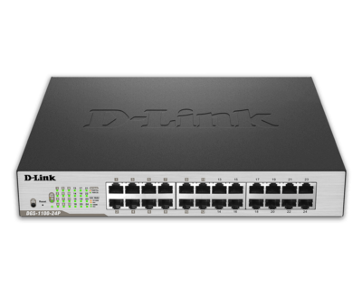
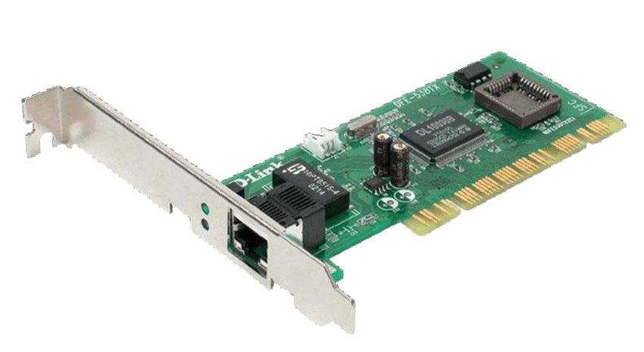
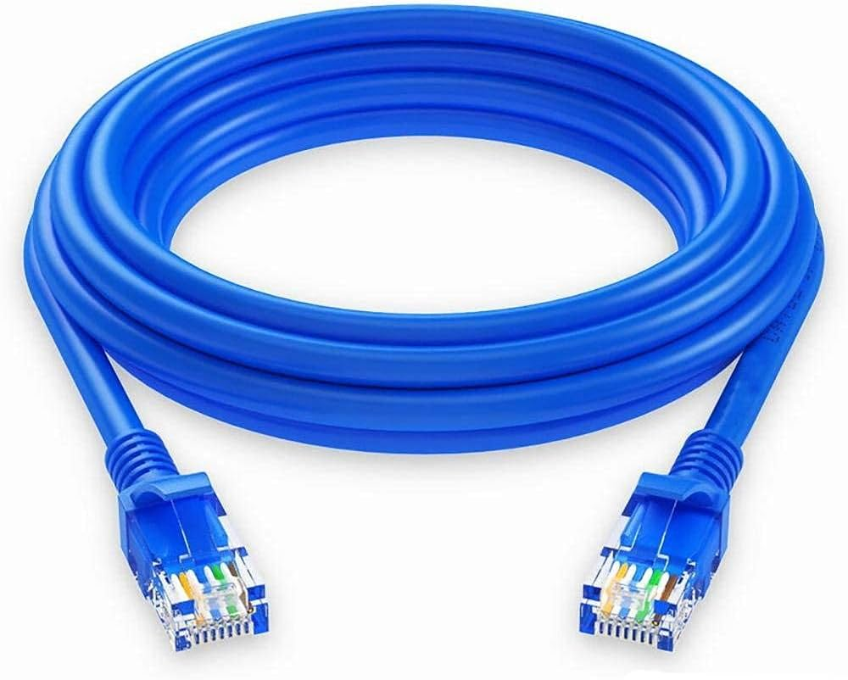
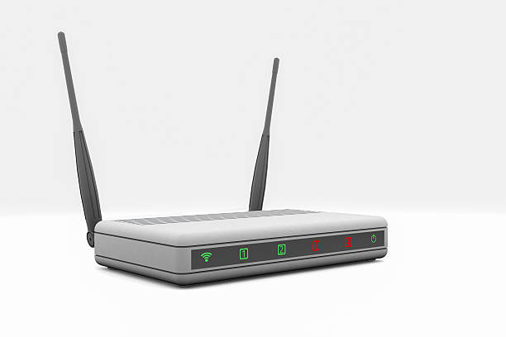
AWS
Network Devices
RJ45
Ethernet cable
NIC- Network interface card
Switch
Router
Internet modem/ Gateway
Notes:
Ref : doc.html -> 1662 to

Slide 13
AWS
Switch
Smart traffic cop for data on a computer network.
Data>Packet>NIC>Switch
Reading the packet source and destination IP
Sending packet to the port>NIC>packet>Data
Notes:
Ref : doc.html -> 1662 to

Slide 14
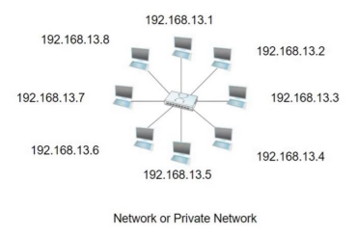
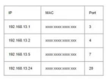
AWS
Example
Notes:
Ref : doc.html -> 1662 to

Slide 15
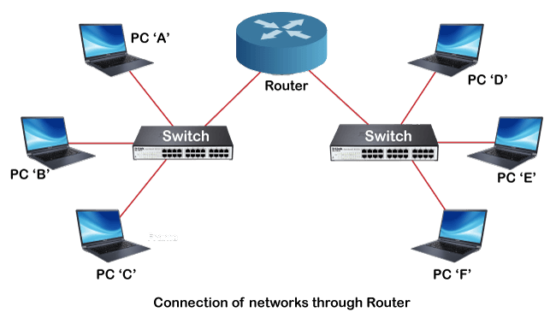
AWS
Router
A Router connects different networks together. It reads data packets , addresses to decide where to send them.
It directs data between devices within your home network and manages traffic between your local network and the Internet.
Notes:
Ref : doc.html -> 1662 to

Slide 16
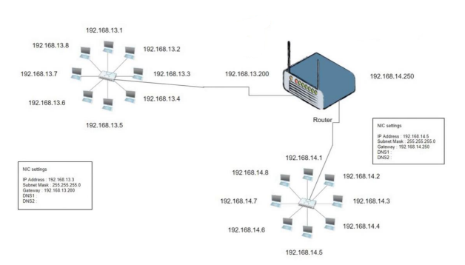
AWS
Router
Notes:
Ref : doc.html -> 1662 to

Slide 17
AWS
How Internet works in our home?
Step1: Browser www.google.com
Step2: DNS-Name to IP conversion
Step3: Public IP will be received by the host
Step4: NIC request the web page to public IP(Packets)
Step5: NIC will receive the response from public IP
Notes:
Ref : doc.html -> 1662 to

Slide 18
AWS
Public IP Range
Class | Start Address | End Address
A | 0.0.0.0 | 126.255.255.255
B | 128.0.0.0 | 191.255.255.255
C | 192.0.0.0 | 223.255.255.255
Class | Start Address | End Address
A | 10.0.0.0 | 10.255.255.255
B | 172.16.0.0 | 172.31.255.255
C | 192.168.0.0 | 192.168.255.255
Notes:
Ref : doc.html -> 1662 to

Slide 19
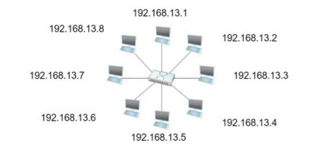
AWS
IP Addressing
An IP(Internet Protocol) address is a numerical label assigned to each device connected a computer network that uses the Internet Protocol for communication. It serves as a unique identifier for devices within a network, allowing them to send and receive data across the internet or other networks.
Notes:
Ref : doc.html -> 1662 to

Slide 20
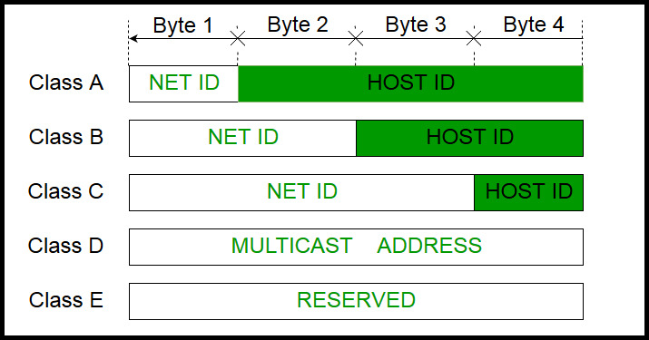

AWS
IP Address Classes & Range
Class | Ranges
A | 1.0.0.1 to 126.255.255.254
B | 128.1.0.1 to 191.255.255.254
C | 192.0.1.1 to 223.255.254.254
D | 224.0.0.0 to 239.255.255.255
E | 240.0.0.0 to 253.255.255.254
255 | 255 | 255 | 255
8bit | 8bit | 8bit | 8bit
Notes:
Ref : doc.html -> 1662 to

Slide 21
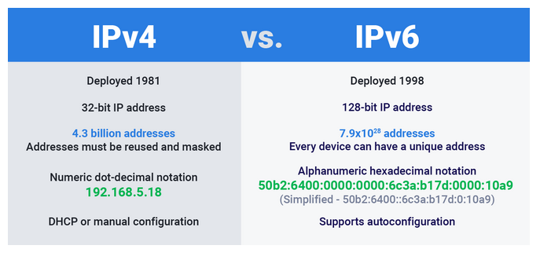
AWS
IPv4 VS IPv6
Notes:
Ref : doc.html -> 1662 to

Slide 22
AWS
Private IP Address - Ranges
10.0.0.1 | 10.0.1.1
10.0.0.2 | 10.0.1.2
----- | ------
10.0.0.255 | 10.0.1.255 | 10.255.255.255
172.16.0.0 | 172.16.1.1
172.16.0.1 | 172.16.1.2
----- | ------
172.16.0. 255 | 172.16.1. 255 | 172.31.255.255
192.168.0.1 | 192.168.1.1
192.168.0.2 | 192.168.1.2
----- | -----
192.168.0.255 | 192.168.0.255 | 192.168.255.255
Notes:
Ref : doc.html -> 1662 to

Slide 23
AWS
Subnetting
In networking, it means taking a large group of IP addresses and splitting them into smaller groups called subnet. This helps manage and organize devices on a network more efficiently, allowing different parts of the network to be treated separately while still being connected.
Benefits
Security
Performance
Simplified N/W Management
East to solve the network issue
Notes:
Ref : doc.html -> 1662 to

Slide 24
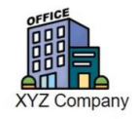
AWS
Example
Department | Members | Network id- Subnet mask- IP range
Human Resource | 10 | 192.168.13.0-255.255.255.240-192.168.13.1 to 192.168.13.14
Sales& Marketing | 10 | 192.168.13.16-255.255.255.240-192.168.13.17 to 192.168.13.30
Production | 50 | 192.168.13.32-255.255.255.192-192.168.13.33 to 192.168.13.94
IT Team | 8 | 192.168.13.96-255.255.255.240-192.168.13.97 to 192.168.13.110
Finance | 5 | 192.168.13.112-255.255.255.248-192.168.13.113 to 192.168.13.118
Notes:
Ref : doc.html -> 1662 to

Slide 25
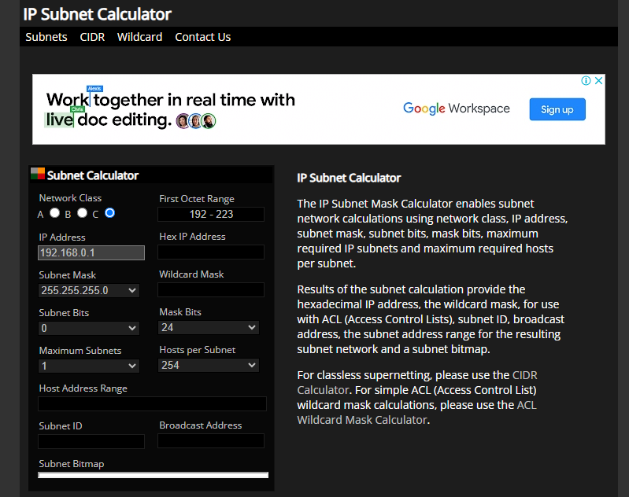
AWS
Notes:
Ref : doc.html -> 1662 to

Slide 26
AWS
What is Port Number?
Port Number is an essential part of the Transport Layer in the Internet Protocol(IP) suite and are used to enable communication between different applications or service on the same computer or between computers on a network.
When data is sent over a network using the Transmission Control Protocol or the User Datagram Protocol, it is addressed to a specific IP address and port number. The combination of IP address and port number helps the network stack on the receiving end route the data to the appropriate application or service running on that device.
Notes:
Ref : doc.html -> 1662 to

Slide 27
AWS
Port numbers range from 0 to 65535.
They are divided into three categories:
Well known ports(0-1023): Reserved for commonly used services like HTTP(port 80) FTP(port 21) and SMTP(port 25).
Registered ports(1024-49151): Used by applications and services that aren’t as widely recognized but are still officially registered with the Internet Assigned Numbers Authority(IANA).
Dynamic or Private Ports(49152-65535): Available for use by applications and services on a temporary or ad-hoc basis
Notes:
Ref : doc.html -> 1662 to

Slide 28

AWS
Example
Your family informed you that, your “Fav” actor stayed in hotel in your area for shooting.
Now you are trying to meet him.
And, you found the receptionist is your friend.
You are asking about the actor stay to your friend receptionist.
He said , he is staying in 6th room and you can go and meet him.
You met your “Fav” actor and happily informed your family.
Actor = Destination Service
Hotel = IP Address
Port = Room Number
Packets = You
Notes:
Ref : doc.html -> 1662 to

Slide 29
AWS
What is Port Forwarding?
Port Forwarding is a networking technique that allows you to redirect incoming network traffic from one port on a router or Firewall to another port on a different devices in your local network.
Inside your local network, you have various devices(computer, servers, Iot devices) that run services and applications. Each of these devices may have a Private IP address.
You can configure your router or firewall to forward incoming traffic on a specific port(external port) to a specific device and port on your local network(internal port).
This configuration tells the router/firewall how to route incoming traffic to the correct destination.
Notes:
Ref : doc.html -> 1662 to

Slide 30
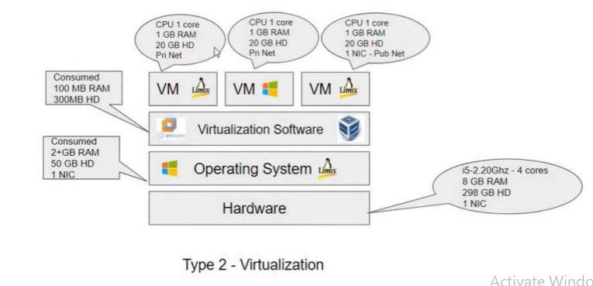
AWS
Virtual box – Networking Modes
Mode | VM →Host | VM← Host | VM1 <--->VM2 | VM→ Net/LAN | VM← Net/LAN
Host – Only | + | + | + | - | -
Internal | - | - | + | - | -
Bridged | + | + | + | + | +
NAT | + | Port forward | - | + | Port forward
NAT service | + | Port forward | + | + | Port forward
Notes:
Ref : doc.html -> 1662 to

Slide 31
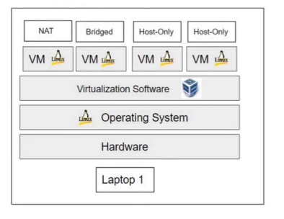
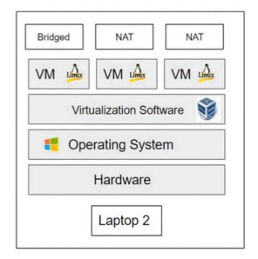
AWS
Example
Notes:
Ref : doc.html -> 1662 to

Slide 32
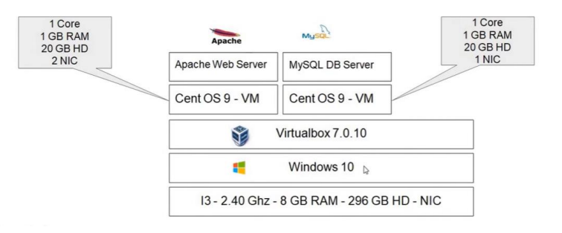
AWS
Test Environment – Plan & Build
Test Environment – Plan :
Steps:
Install Virtual box
VM Network setup
> Including port forwarding setup
Create and configure new virtual machine
VM Backup & Restore
SSH (putty) and FTP (WinSCP) connection setup
Notes:
Ref : doc.html -> 1662 to

Slide 33
AWS
Virtual box Setup
Step1: Remove unwanted applications and files to free up space.
Step2: Download Virtual box setup from www.virtualbox.org site.
Step3: Install the setup file.
Virtual box Network Setup
Step1: Virtual box > Tools > Network
Step2: NAT Networks > Create New > Configure IP Address setup
Step3: Port Forwarding > Configure SSH and Web port forwarding setup
Notes:
Ref : doc.html -> 1662 to

Slide 34
AWS
Virtual Machine Setup
Step1: Download CentOS Stream 9 ISO file from www.centos.org.
Step2: Create Virtual Machine.
Step3: Install Cos Stream 9 ISO file in Virtual Machine.
Virtual Machine Network Setup
Step1: Ensure the network Adapter for Bridged Network.
>This is for web server VM and we need internet access for our VM
> Please consider this is Public Network
Step2: Configure “NAT Network”
> This is for Database Server VM and only web server host should access the VM
> It should have Internet access and consider this as Private Network
Notes:
Ref : doc.html -> 1662 to

Slide 35
AWS
Virtual Machine Backup & Restore Setup
Step1: Take VM snapshot.
It will capture a state of a VM
We can take clone from a VM snapshot
Step2: Take VM clone
This will save time to create new VM
It will be backup of our VM setup
SSH and FTP Connection Setup
Download “Putty” software tool to create SSH connection
Download WinSCP for “File Transfer” support
Let me show you the Live configuration !
Notes:
Ref : doc.html -> 1662 to

Slide 36
AWS
Topics!
Hostname Setting
IP Address Setting
Checking the Time & Date , System & OS information
Understanding the Directory Structure
Basic User Management
Basic File Management
Basic Package Management

Slide 37
AWS
Hostname Setting
Step1: Type “hostname <provide your name>”
Step2: Check the provided hostname, type “hostname”
Step3: We need to open “/etc/hostname” file and write our hostname.
IP Address Setting
Step1: Type “nmtui”
Step2 : “Edit connection” > Select N/W card> configure> OK> Back> Activate the connection
Notes:
Ref : doc.html -> 1662 to

Slide 38
AWS
Date , System & OS Information
Type “Date”
Type “uname-a” , it will show below important details
>Hostname, Processor Architecture, Kernel and Date
Type “cat/proc/version” for some more information about Linux
To check RAM details, Type “cat/proc/meminfo” or “top” command
To check HD details, Type “cat/proc/partitions” and “df – h” command
Notes:
Ref : doc.html -> 1662 to

Slide 39
AWS
Directory Structure
/-slash → It is the parent directory for all other file and folders. Only root user is having permission to makes changes.
/home → It contains normal user profiles. By default, normal users don’t have permission to make changes in other folder.
/boot → It contains Linux OS bootable files. GRUB2 Loader and VMLINUZ – Kernel files.
/bin → It contains binary files for the normal users.
/sbin → It contains binary files for the root user.
/etc → It contains system and server configuration files.
/dev → It contains system’s device file informations.
Notes:
Ref : doc.html -> 1662 to

Slide 40
AWS
Basic User Management
Usually a user is a Person. A User account contains permissions to perform operations in the operating system.
→ 3types of user “root user” – “normal user” – “service user”
We know, how to login in OS after the boot process but how to switch user account in same terminal?
→ Type “su<username>” and provide password
Notes:
Ref : doc.html -> 1662 to

Slide 41
AWS
How to add new user? – How to assign password to the new user? – How to check the user information's?
→ Type “useradd<new user>”- Type “passwd<new password>”- Open”/etc/passwd” file
How to create a group? – How to add user in the group? – How to check group information's?
→ Type ”groupadd<new group name>” – Type “usermod –aG <group name> <user name> - Open”/etc/group”
Notes:
Ref : doc.html -> 1662 to

Slide 42
AWS
Basic File Management
Type “pwd” – To check the present working directory.
Type “ls” – To check files in the directory.
Type “cd<provide location> - To move other directory location
Type “mkdir<provide location> - To create new directory
Type “touch <name> - To create empty files
Type “cp<file name>/ <location>/<new file name>/”- To copy the files to some other location
Notes:
Ref : doc.html -> 1662 to

Slide 43
AWS
Type “cp –r<folder name>/<location>/<new folder name>/” – To copy the files to some other location
Type “mv <file name>/<location>/<new file name>/” – To move the files to some other location
Type “rm <file name>” - To delete the file
Type “rm -r<folder name>” – To delete the folder
Notes:
Ref : doc.html -> 1662 to

Slide 44
AWS
Basic File management – File Editor
CAT
Cat <file name> - Help us to shown the content from the file.
Cat> <file name> - Help us to write or overwrite from the file.
Cat>> <file name> - Help us to add on new lines from existing file content.
VI
Vi<file name> - Help us to show, edit, save the content from the file in separate editor mode.
:w – Save the file
:q – exit the editor, if the file has been modified use the following command.
Notes:
Ref : doc.html -> 1662 to

Slide 45
AWS
:q! – exit the editor without saving
:wq – exit the editor and save the file
: set nu – setting numbers to each line
:search – searching the words
VIM
If you have not installed VIM package kindly install the Vim using ”yum install vim –v”.
Vim also having same features as VI editor.
It has new feature of showing contents in colour full styles.
Notes:
Ref : doc.html -> 1662 to

Slide 46
AWS
Basic Package Management
How to manage packages in centos with YUM?
1.YUM(Yellowdog Updater Modified):
Yum is one of the older package managers and was widely used in Red Hat Enterprise Linux (RHEL) and its derivatives.
Yum resolves package dependencies automatically. If a package relies on other packages, Yum will find and install those dependencies for you.
It works with “repositories” which are online locations that stores software packages.
You can use YUM to install, remove or update packages with simple commands,
Notes:
Ref : doc.html -> 1662 to

Slide 47
AWS
yum install package_name
yum update package_name
yum remove package_name
How to manage Packages in Centos with DNF?
DNF(Dandified YUM) is the next-generation package manager, designed to replace YUM in newer version of Hat-based systems.
Like YUM, DNF manages packages from repositories, but it offers improved performance and feature.
DNF uses more modern architecture, which makes it faster and more reliable than YUM.
You can perform operations like package installation or updates using DNF, just as You would with YUM.
Notes:
Ref : doc.html -> 1662 to

Slide 48
AWS
Web Application for Test Environment
Steps to follow:
Step1: Install and configure Apache HTTPd and PHP service in web server host
Step2: Install and configure MySQL Database in DB Host
Step3: Design your Application in PHP
Step4: Write your Application code in PHP
Step5: Understand, How the application works in local environment?
Step6: Deploy and Test your application
Notes:
Ref : doc.html -> 1662 to

Slide 49
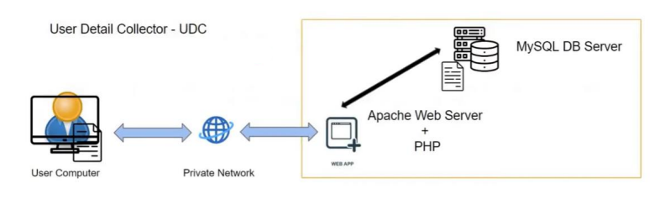
AWS
Domain Name Service
It is used for name to IP conversion and Ip to name conversion
We need to configure DNS temporarily for this project in Windows and Linux
Design Your Application
User Detail Collector – UDC
Notes:
Ref : doc.html -> 1662 to

Slide 50

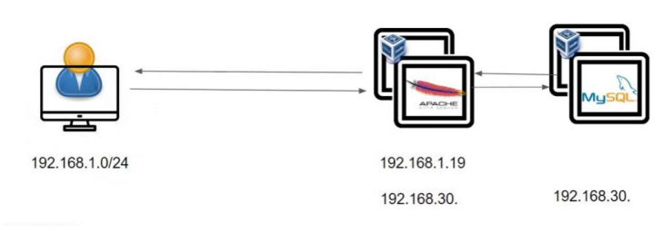
AWS
Write your application
I have already written the code in PHP so please download the PDF document and follow the steps with me
How Application Works?
Notes:
Ref : doc.html -> 1662 to

Slide 51
AWS
Deploy the Application
Step 1: Prepare MYSQL DB for our PHP application.
Step 2: Ensure the connectivity with PHP – DB.
Step 3: Paste the PHP code in required location.
Step 4: Restart the required services and check the service status.
Step 5: Access the PHP application from user end.
Notes:
Ref : doc.html -> 1662 to

Slide 52

AWS
Please refer the UDC.pdf file for full set of configuration
Notes:
Ref : doc.html -> 1662 to

Slide 53
AWS
Configure Temporary DNS
Now your are able to access the PHP web-app in browser with IP address.
How to configure temporary DNS in Windows and Linux?
Why we are configuring this now?
Notes:
Ref : doc.html -> 1662 to

Slide 54
AWS
Configure Domain Name Server in Windows :
1. Open Run Panel and type system32
2. Open drivers folder
3. Under drivers -> etc folder
4. Under etc -> hosts
5. Open the hosts file with read and write access (Properties – Security - Users(jayanth Lenovo) – Edit – Full control – allow – close)
6. Open the file in Notepad and enter your IP and domain new name and save it.
Notes:
Ref : doc.html -> 1662 to

Slide 55
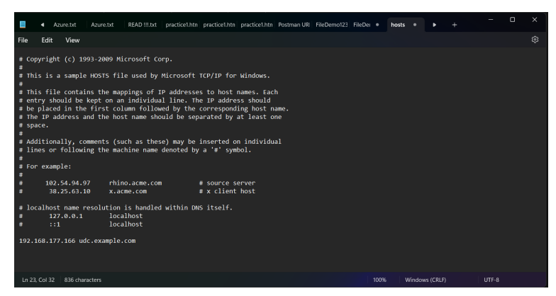
AWS
Notes:
Ref : doc.html -> 1662 to

Slide 56
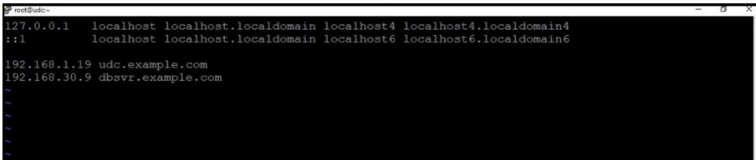
AWS
Configure Domain Name Server in Linux :
Vi /etc/hosts
2.
3. Save it (wq!)
Notes:
Ref : doc.html -> 1662 to

Slide 57
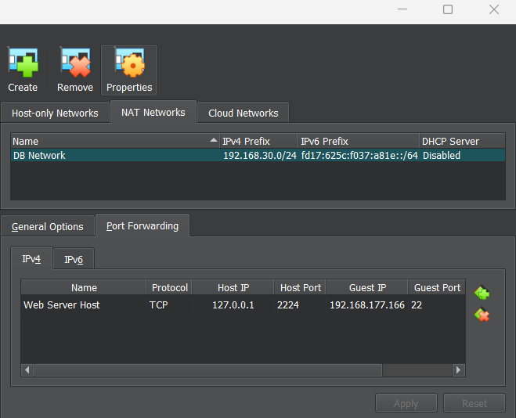
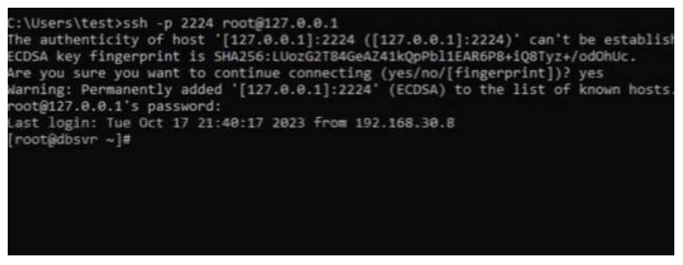
AWS
Port Forwarding :
Notes:
Ref : doc.html -> 1662 to

Slide 58
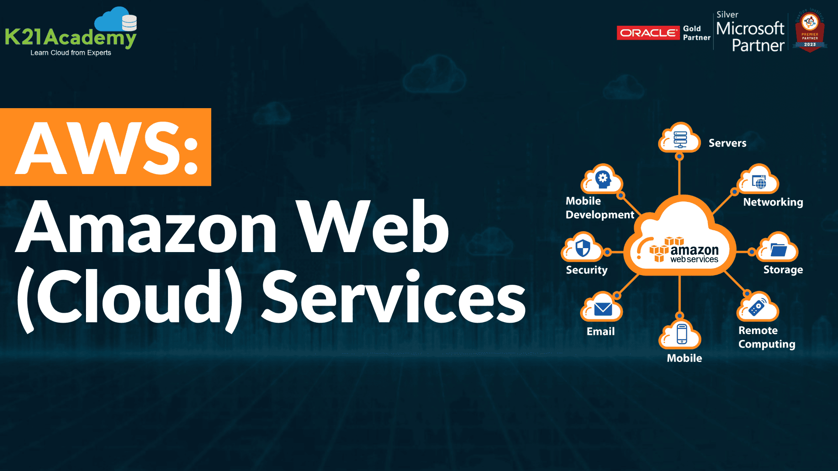
AWS
Notes:
Ref : doc.html -> 1662 to

Slide 59
AWS
Amazon Web Services
AWS is a comprehensive cloud computing platform.
AWS provides a wide range of cloud services, including computing, storage,
Databases, content delivery, machine learning and analytics as services to help individuals, businesses and organizations.
They will build and deploy scalable and cost-effective applications and services in AWS.
Notes:
Ref : doc.html -> 1662 to

Slide 60
AWS
What is Cloud Computing?
Cloud computing is a technology that allows you to access and use computer services and resources like storage , processing power, and software, over the internet, rather than on your local computer.
It’s is like renting or sharing a computer infrastructure with others, and you can use as much or as little as you need.
Common examples of cloud services include online storage(example-Dropbox), web-based email (example-Gmail), and cloud platforms like Amazon Web Service (AWS) or Microsoft Azure for business to run applications and store data.
Notes:
Ref : doc.html -> 1662 to

Slide 61
AWS
Why Cloud Computing?
Quick Infrastructure Deployment
Scalability and Flexibility
Cost savings
Prevent Data Loss
Advanced Security
Notes:
Ref : doc.html -> 1662 to

Slide 62
AWS
Virtualization connection with Cloud Computing?
Virtualization technology plays a fundamental and interconnected role in cloud computing.
Foundation of Cloud Infrastructure:
Virtualization is a underlying technology that enables the creation of virtual machines or
virtual environments within a single physical server or across multiple physical server.
cloud computing relies heavily on virtualization to create a building blocks for cloud Infrastructure.
It often involves the use of virtualization technologies within data centers to create and
manage virtual servers, storage and networking.
Notes:
Ref : doc.html -> 1662 to

Slide 63
AWS
Data Center
Data centers are physically facilities that contains servers, networking equipment, and storage.
Multiple data centers can be used for redundancy and high availability. Data and applications can be replicated or distributed across different data centers to ensure continuity in case of failures or disasters.
Managing multiple data centers can be complex and costly, as it involves maintaining hardware, networking and power infrastructure.
Notes:
Ref : doc.html -> 1662 to

Slide 64
AWS
AWS - Architecture
AWS architecture is the structure and layout of AWS services and components that work together to create a scalable and reliable cloud computing environment.
Mainly, below three we need to know
Regions
Availability Zones Global Infrastructure
Edge Locations
Notes:
Ref : doc.html -> 1662 to

Slide 65
AWS
Availability Zone
Availability Zone
Availability Zones are like separate data centers in the same city.
AWS sets up multiple availability zones in each AWS region, and they are located close to each other but designed to be physically isolated from one another.
They provide redundancy and fault tolerance. If one availability zone experiences an issue, your data or applications can continue running in another without disruption.
You can think of availability zones as AWS’s way of making sure your applications and data are highly available and reliable.
Notes:
Ref : doc.html -> 1662 to

Slide 66
AWS
Edge Location
Edge Location
Edge locations are like small data centers located in different cities and regions around the world.
They are part of Amazon Cloud Front, which is content delivery network(CDN) service provided by AWS.
Edge Locations store cached copies of frequently accessed data, like images and videos, to reduce the load on the main server.
When a user requests content, it’s served from the nearest edge location, which makes the content load faster and reduces the load on the central server.
Edge locations are crucial for delivering web content quickly to users all over the globe.
Notes:
Ref : doc.html -> 1662 to

Slide 67
AWS
Things required to create AWS account
E-mail address
Phone Number
Credit or Debit Card
Visit “aws.amazon.com” to create your account
Notes:
Ref : doc.html -> 1662 to

Slide 68
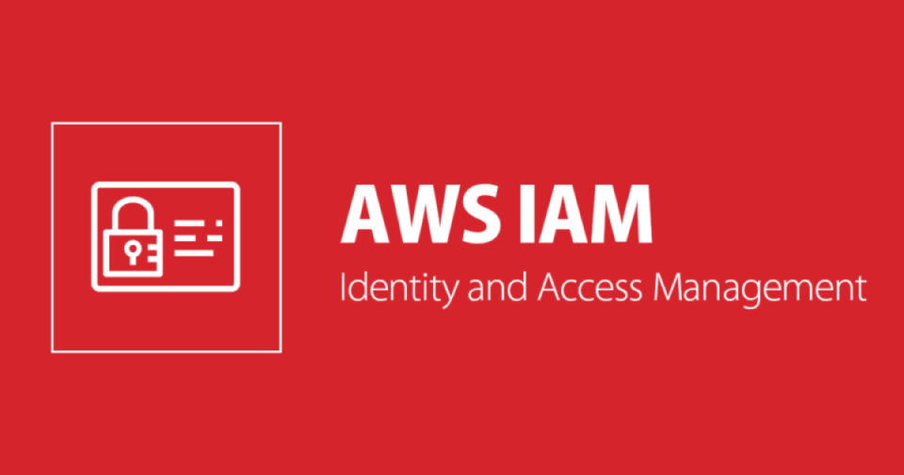
AWS
Identity and Access Management
IAM
What is IAM?
Users
Groups
Roles
Policies
IAM Account Settings
Notes:
Ref : doc.html -> 1662 to

Slide 69
AWS
What is IAM?
IAM helps you to manage users and their level of access in AWS.
Create users and assign permissions
Create groups and roles
Control access to AWS resources (like S3, EC2)
We have two types of AWS user account.
Root account – It is associated with your email address. The account owner with complete access to all AWS service and resources. You’re the root user if you created the AWS account and you sign in using your root user email and password.
IAM user- The IAM user represents the human user or workload who uses the IAM user to interact with AWS service.
Notes:
Ref : doc.html -> 1662 to

Slide 70
AWS
Roles and Policies
AWS IAM roles and policies are fundamental components of Amazon Web Service (AWS) that help control and manage access to AWS resources.
IAM roles determine who gets access to AWS resources, and IAM policies define what they can do with that access. Roles and policies work together to help you manage and secure your AWS environment by ensuring that only authorized entities have the right level of access to AWS services and data.
Notes:
Ref : doc.html -> 1662 to

Slide 71
AWS
IAM Roles
It is predefined sets of permissions that you can assign to AWS resource.
These roles help ensure secure access to AWS resources by granting permissions on temporary and as- needed basis.
IAM Policies
IAM policies are like rulebooks that specify what actions are allowed or denied for AWS users or resources.
Policies are written in JSON format and define the permissions associates with roles, users, groups.
These policies are used to control who can do what within AWS, which resources they can access, and under what conditions.
Notes:
Ref : doc.html -> 1662 to

Slide 72
AWS
What we are going to do now?
Create a group and assign any AWS resource permission.
Create new user and assign this user to the group.
Try to login via new IAM user and check the permissions.
Understand programmatic access and IAM account settings.
Install and configure AWS CLI using new user account.
Note: IAM is not region specific, it is universal
Notes:
Ref : doc.html -> 1662 to

Slide 73
AWS
Programmatic Access
1. Go to IAM Service
2. Click user’s section
3. Select the user which you want to give programmatic access
4. Click the ‘Security credentials’
5. Click the Access Keys
6. Choose the Command Line Interface (CLI)
7. Create access Key and download the key details
8. Programmatic access is created and we can configure later
Notes:
Ref : doc.html -> 1662 to

Slide 74
AWS
IAM Account Settings
1.Go to Account Settings
2. Edit your Password policies – according to pattern
3. Then all alerts will be gone
Notes:
Ref : doc.html -> 1662 to

Slide 75
AWS
AWS – CLI Install
1. Open the VM
2. Take snapshot of web server and give a name as Before Cloud
3. Start the web server
4. Mkdir aws-cli and cd aws-cli and install the below
5. Install the AWS CLI - curl "https://awscli.amazonaws.com/awscli-exe-linuxx86_64.zip"
-o”awscliv2.zip”.
6. yum install unzip
7. unzip awscliv2.zip
8. cd aws
9. ./install and check the version aws --version
Notes:
Ref : doc.html -> 1662 to

Slide 76
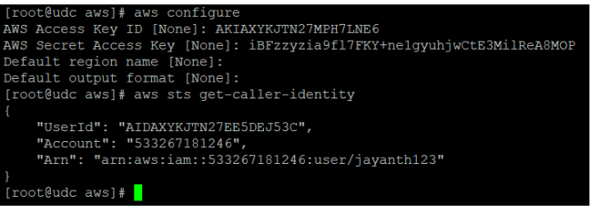
AWS
AWS – CLI Configure
Run the command : aws configure
Notes:
Ref : doc.html -> 1662 to

Slide 77
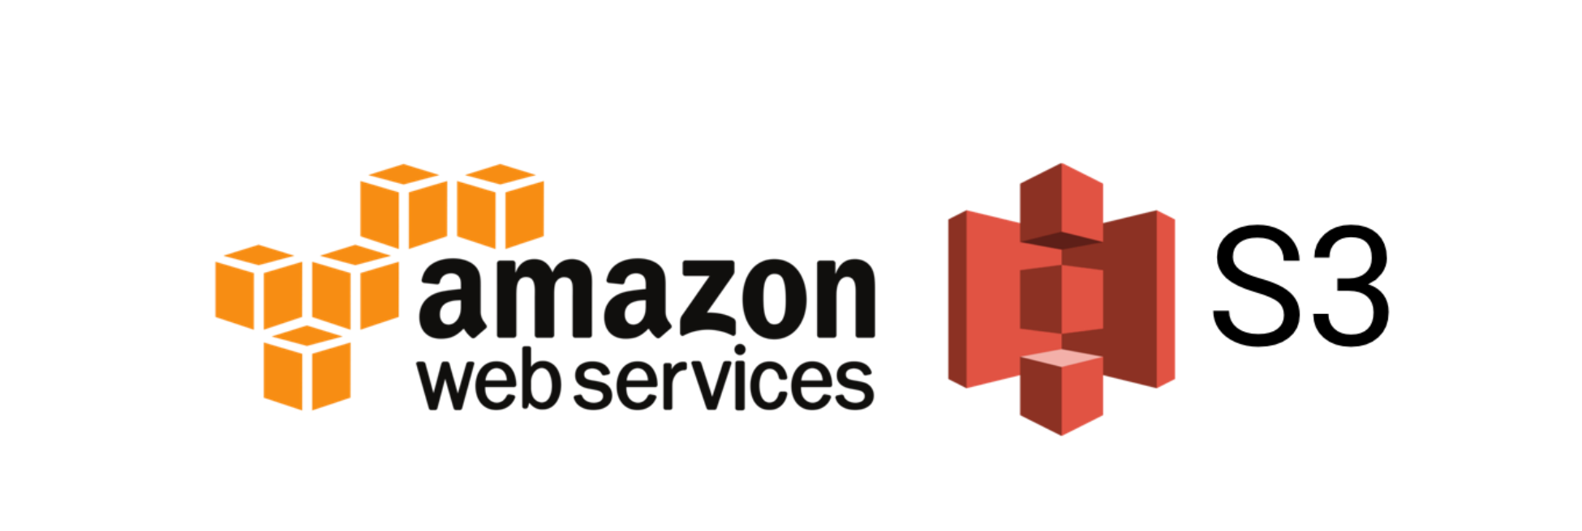
AWS
Notes:
Ref : doc.html -> 1662 to

Slide 78
AWS
What we are going to learn?
What is S3?
Benefits of S3
S3 Operations
Host a Static Website in S3
S3 Storage Classes
S3 Objects – Life Cycle Management Policy
S3 Versioning
S3 Replications
Notes:
Ref : doc.html -> 1662 to

Slide 79
AWS
What is S3?
Amazon Simple Storage Service (Amazon S3) is an object storage service that offers industry-leading scalability, data availability, security and performance.
Amazon S3 provides management feature so that you can optimize, organize and configure access to your data to meet your specific business, organizational and compliance requirements.
User can store and retrieve any type or amount of data (objects or files) in S3 over the web.
User can upload files from 0 bytes to 5 TB in size to S3 buckets (folder)
Bucket names must be unique across all AWS accounts in all the AWS regions within a partition.
Notes:
Ref : doc.html -> 1662 to

Slide 80
AWS
Benefits of S3
Unlimited Storage Space
Data High Availability – 99.99%
Data Durability – 99.99999999999%
Simple Interface – Web & CLI
Data Security
Notes:
Ref : doc.html -> 1662 to

Slide 81
AWS
S3 Operations
Create Bucket
Upload a file (object) and check properties
Enable Public Bucket Access
Accessing all objects in the bucket publicly
Deleting the objects
Notes:
Ref : doc.html -> 1662 to

Slide 82
AWS
How to create a Static website in S3?
Create a sample HTML file.
Create a bucket with Public access.
Upload the sample HTML file to the bucket.
Create a public access over the file (object ACL).
Create a public access over the bucket.
Notes:
Ref : doc.html -> 1662 to

Slide 83
AWS
S3 Storage Classes
S3 Standard
S3 Intelligent Tiering
S3 Standard IA (Infrequent Access)
S3 One Zone IA
S3 Glacier
S3 Glacier Deep Archive
Notes:
Ref : doc.html -> 1662 to

